Slide 1
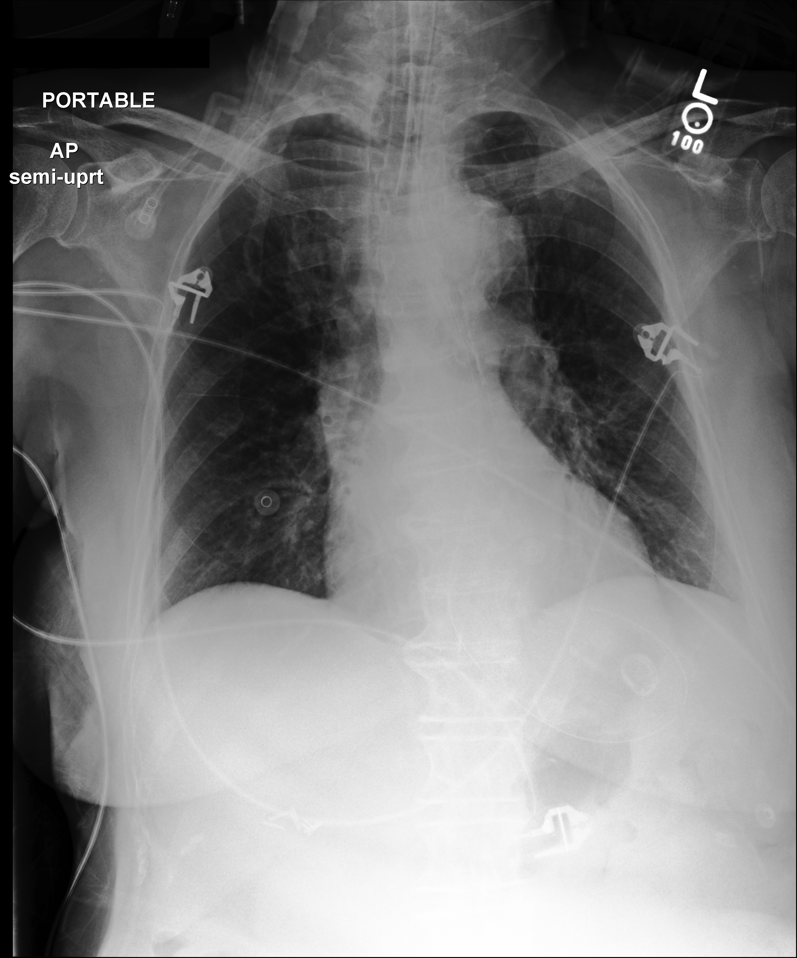
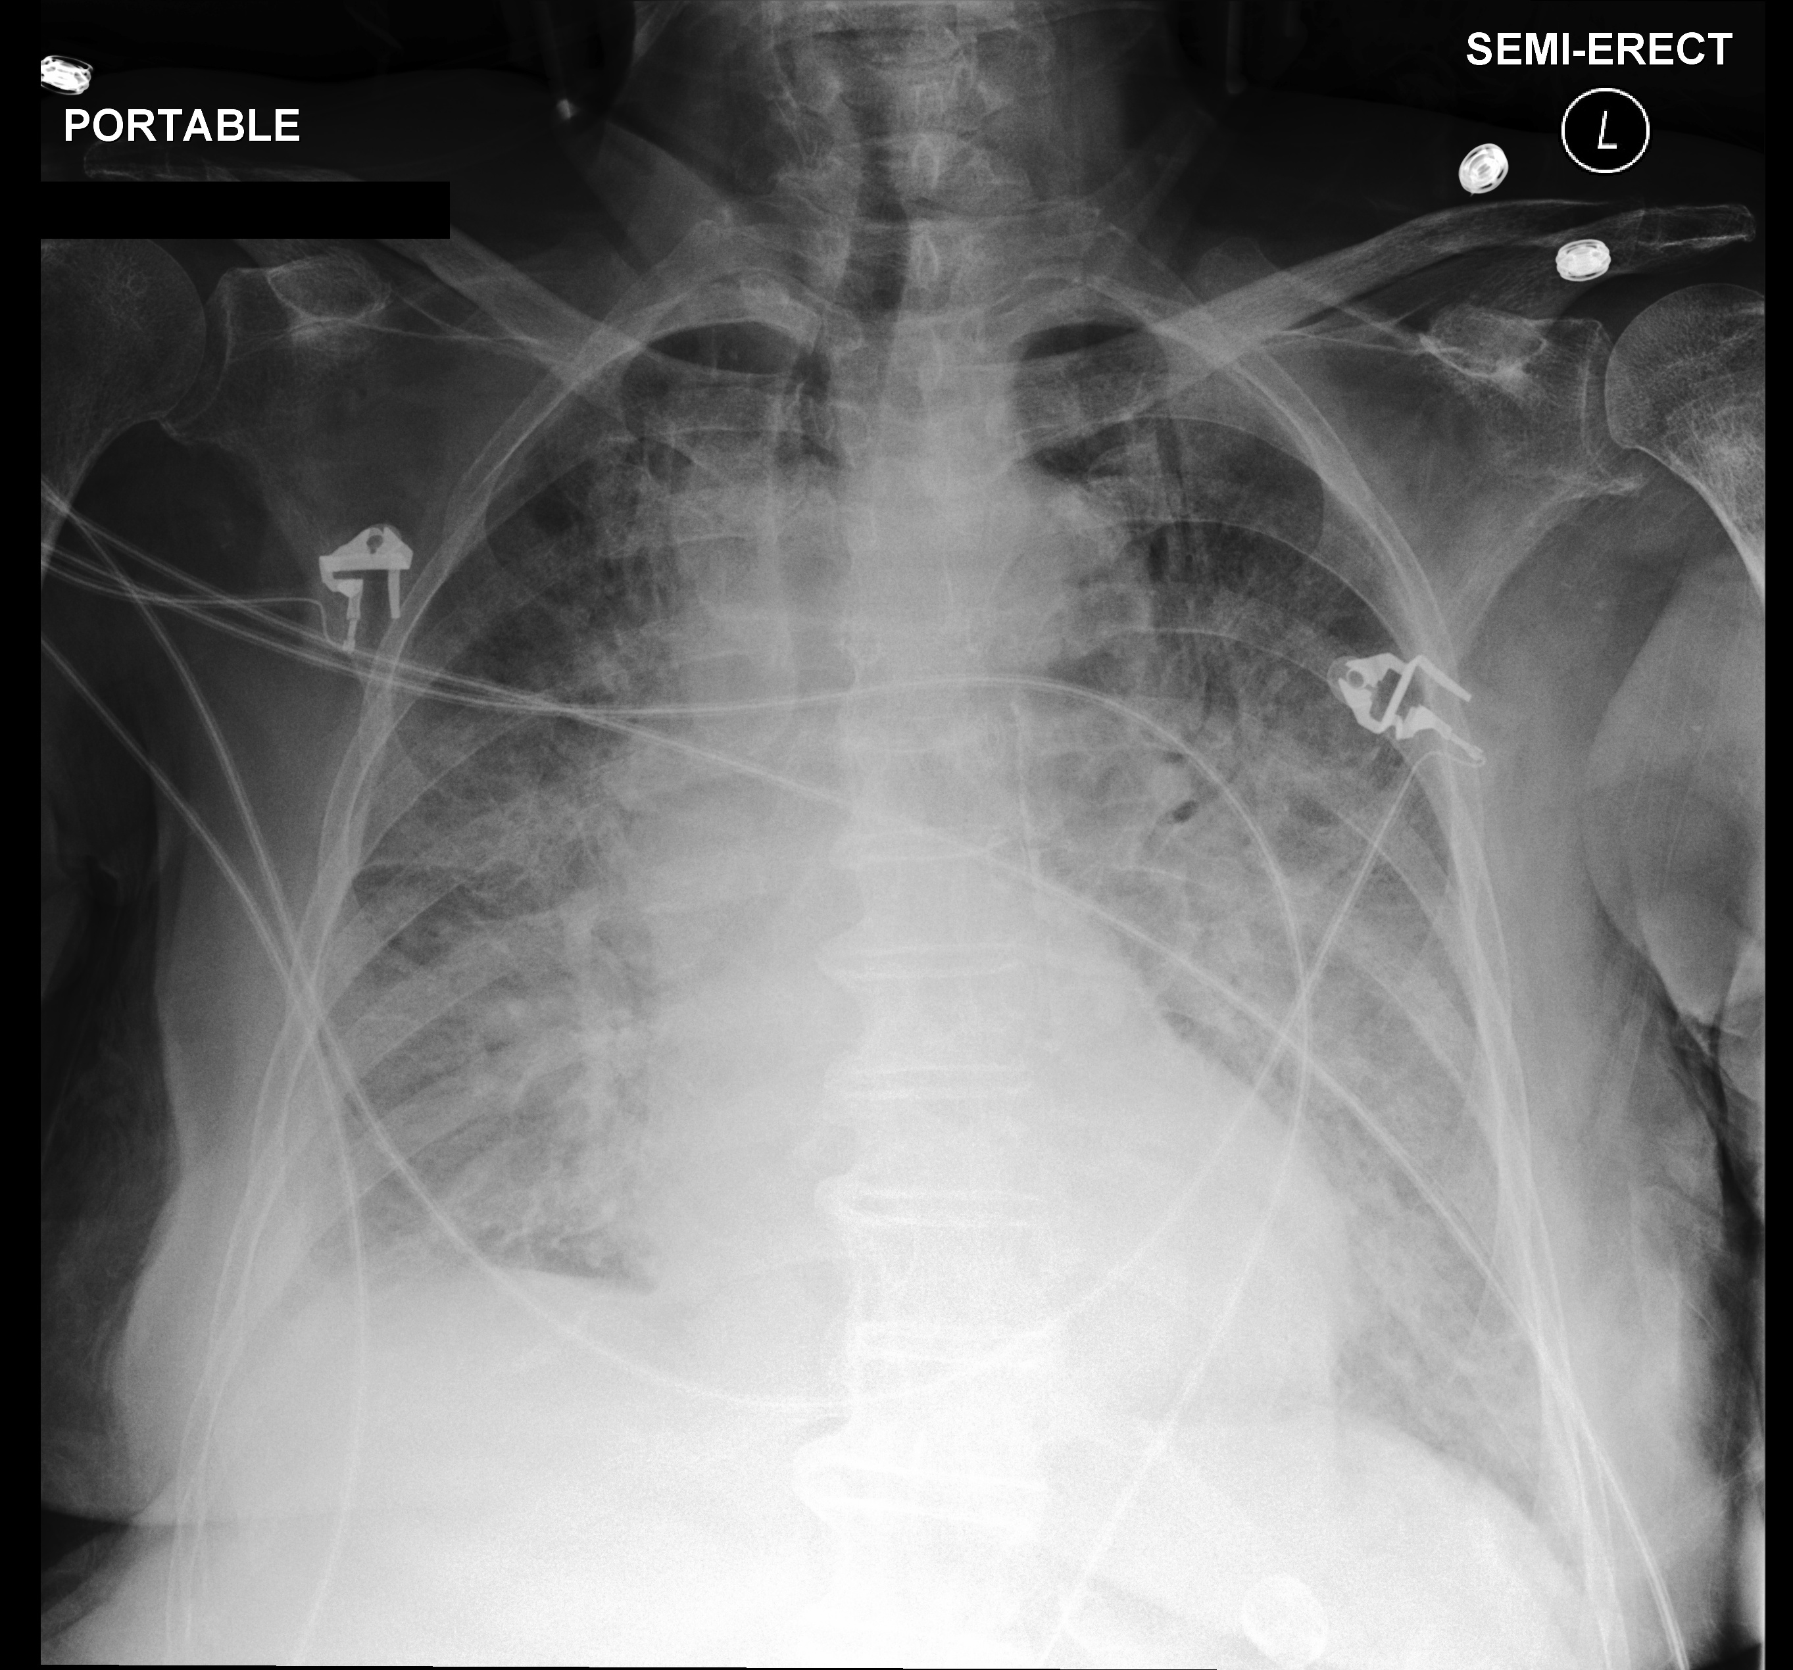
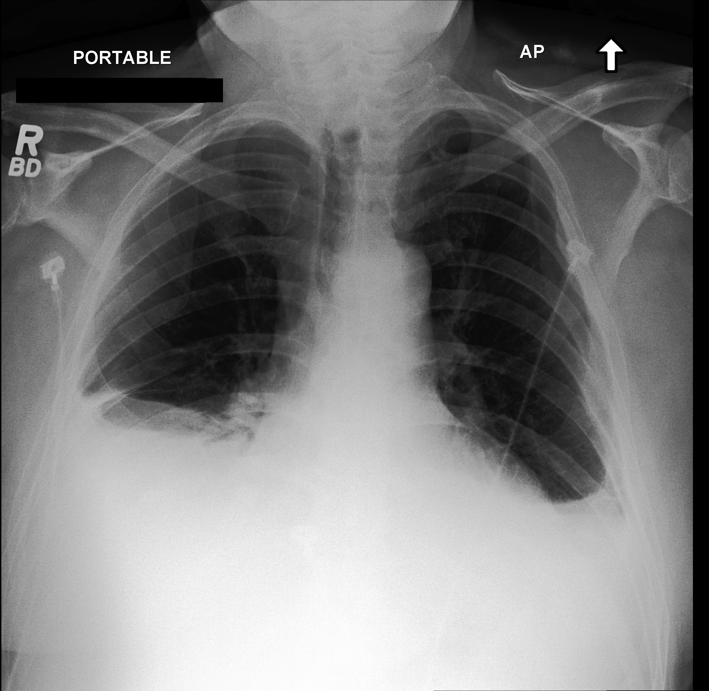
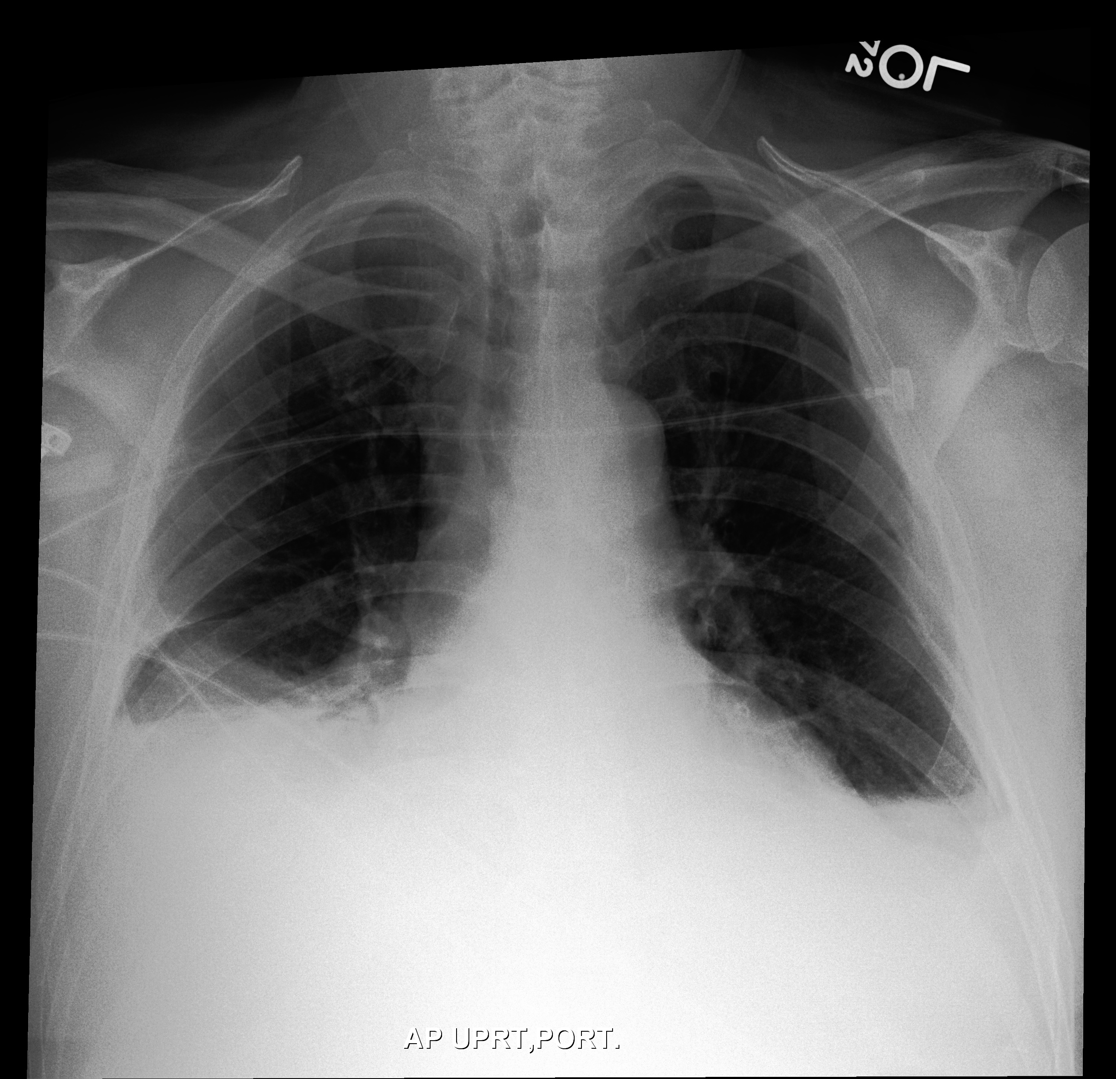
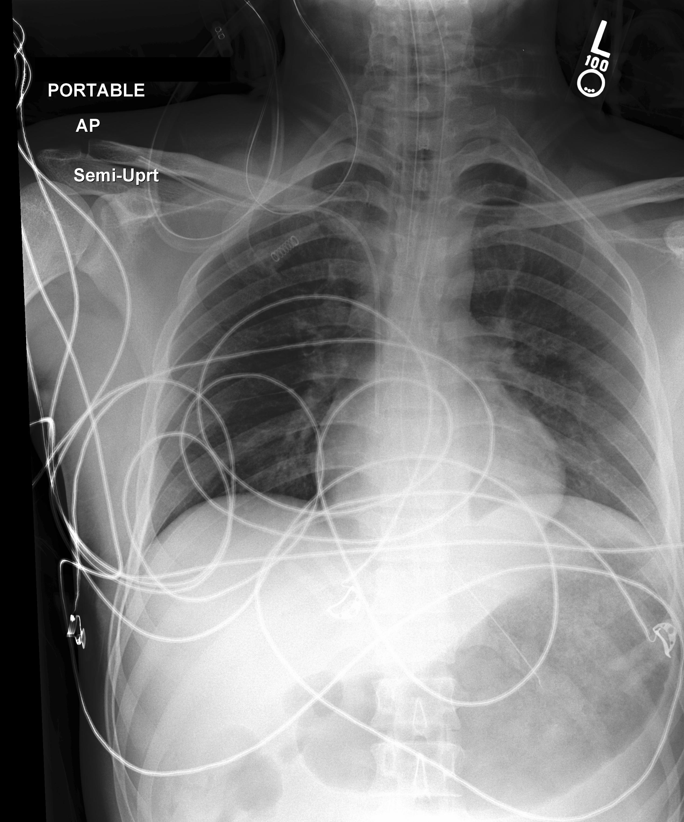
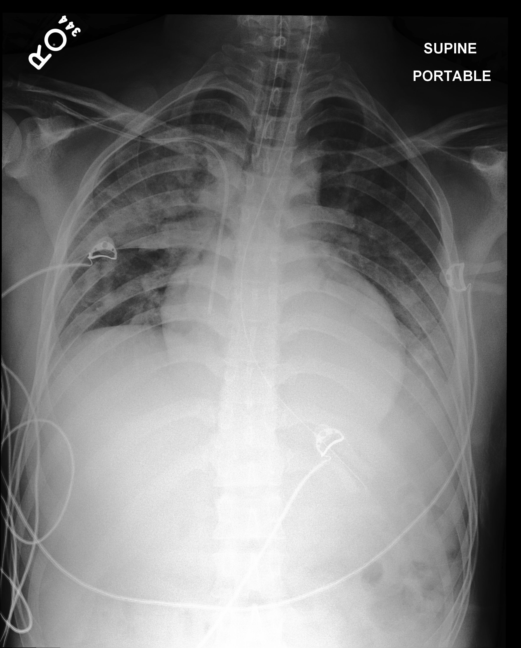
A
Current
Observed follow-up
Clear change
20.1 h · 0–24 h · SICU
No reported edema or
pleural effusion →
marked bilateral
opacity and pulmonary
edema; small right
pleural effusion.
20.1 h
B
Current
Observed follow-up
Stable follow-up
24.0 h · 0–24 h · SICU
Persistent bibasal
opacification, pleural
effusions, and
compressive
atelectasis with little
interval change.
24.0 h
C
Current
Observed follow-up
Clear change
50.5 h · 24–72 h ·
Trauma SICU
No focal opacity or
pleural effusion →
extensive bilateral
parenchymal opacities,
greatest in the right
upper lung; probable
multifocal pneumonia,
possible effusion.
50.5 h

